Slide 1

AI-based Photo Relevance Detector for Location Tags
Date: 30/08/2025
Degree: B.Tech CSE ML&AI
Project Guide:
Ms. Ekta Patel
Bhavishya Chauhan (22SE02ML010)
School of Engineering, P P Savani University, Surat, Gujarat, India-394125

Slide 2
Title: AI-based Photo Relevance Detector for Location Tags
Objective:
To determine whether an uploaded photo is contextually relevant to a given landmark or location description by using an image classification model and generating a relevance score.
2

Slide 3
Introduction / Problem Statement
Background: On platforms like Google Maps or tourism apps, users often upload photos tagged to locations. Many of these are irrelevant (e.g., selfies, unrelated objects), which reduces content quality.
Problem Statement: How can we automatically detect whether an uploaded image is relevant to the specified landmark/location description?
Importance: Improves content moderation, enhances user experience, and ensures higher quality of location-based data.
3

Slide 4
Scope of Work
In Scope:
  Landmark classification using a trained CNN model (landmark_classifier.h5).
  Streamlit application for image upload, description input, preview, and result display.
  Simple text–class match-based relevance scoring.
Out of Scope (Current Phase):
  GPS/EXIF metadata analysis.
  Advanced multimodal matching using embeddings.
  Full-scale production deployment.
4

Slide 5
Methodology / Proposed Approach
Model & Data: Trained CNN-based landmark classifier; class mappings stored in class_indices.json.
Preprocessing: Resize images to 224×224, normalize pixel values.
Prediction: Model outputs predicted class and confidence score.
Relevance Scoring Logic:
  If predicted class matches any of the five user descriptions → score = probability × 100.
  If no match → score = probability × 50 (partial credit).
5

Slide 6
Methodology / Proposed Approach
User Interface: Streamlit app with:
  File uploader.
  5 description fields.
  Image preview.
  Relevance score and prediction display.
6

Slide 7
Current Progress with Evidence
Code: Single-file app (app.py) completed with integrated model loading, prediction logic, and Streamlit UI.
Model: landmark_classifier.h5 trained on landmark image dataset.
7

Slide 8
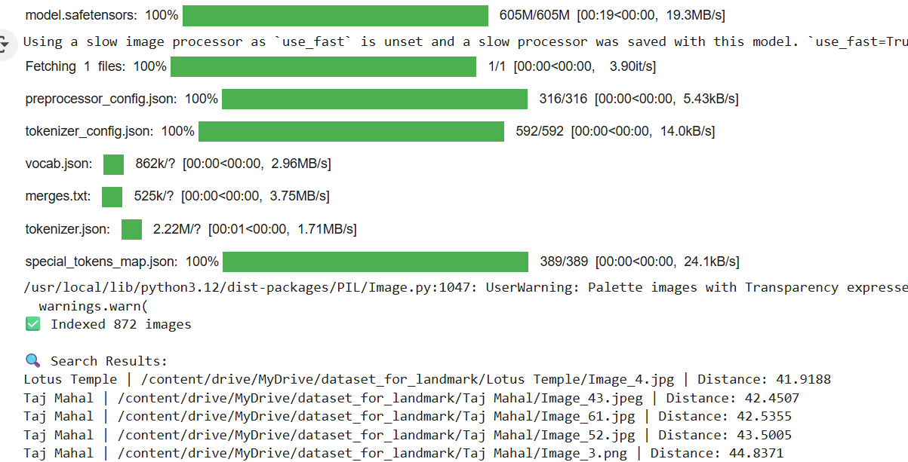
Test Run Evidence:
Model tested locally with sample landmark images; predictions are accurate for trained classes.
8

Slide 9
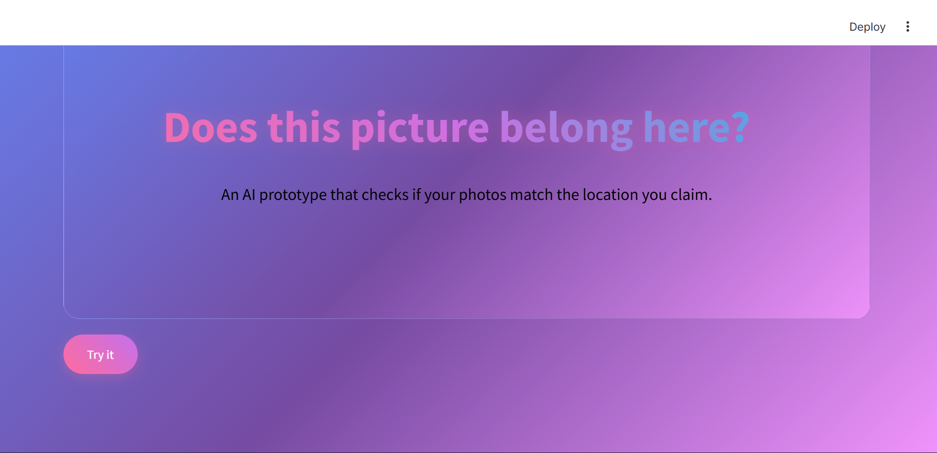
UI Screenshots with result:
9

Slide 10
Challenges Faced & Possible Solutions
Challenge | Possible Solution
Model accuracy may drop for unseen landmarks | Use larger dataset and fine-tune with diverse images
Exact string matching between predicted class & descriptions can fail | Implement semantic similarity using NLP models (e.g., BERT, CLIP)
Handling selfies or irrelevant objects | Integrate face/object detection to penalize such cases in scoring
10

Slide 11

FUTURE SCOPE
Integrate GPS metadata parsing and cross-check with location coordinates.
Replace exact string matching with semantic similarity scoring.
Deploy the Streamlit app to a cloud platform for public testing.
Expand the model’s training dataset to improve generalization.
Future scope of system
11

Slide 12
THANK YOU..!!
T004/ Version 1.0

